Slide 1
Chp.5/ Section 9 – page 543 What Limits & Determines An Atom’s Mass? Learning targets:
*Explain why the atomic masses of some elements are not whole #’s
*Use symbols to represent different isotopes
*Determine the composition of the nucleus from an atom of its isotope
*Examine atomic mass to determine the most abundant isotopes

Slide 2
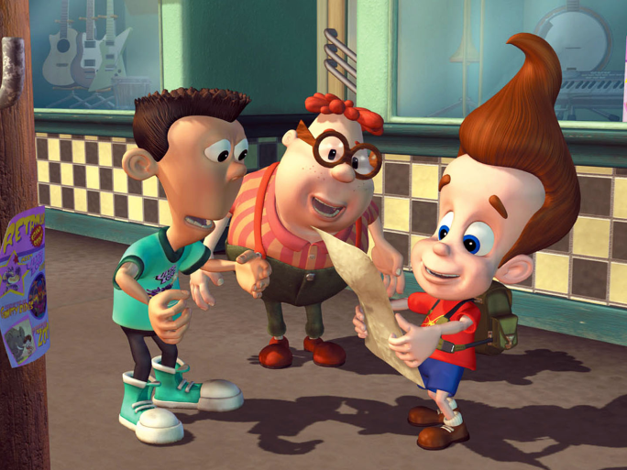
CALCULATING the number of NEUTRONS

Slide 3
CALCULATING the number of NEUTRONS:
*Atomic mass is the protons + neutrons
So, take Radium (Ra) as an example.
Atomic mass is 226.
Atomic mass minus (-) # of protons =
# of neutrons
226-88 = 138 -- > Radium has 138 neutrons.
Copper:
Atomic mass = 64 (always round to the nearest whole number!)
# of protons = 29
So, 64-29 = 35 → Copper has 35 neutrons

Slide 4
3. c) I made this chart
Element | Protons | Neutrons | Atomic Mass (amu)
Lithium
Boron
Nitrogen
Fluorine
Beryllium
Carbon
Oxygen
Neon
Use WHOLE numbers

Slide 5
3. c)
Element | Protons | Neutrons | Atomic Mass (amu)
Lithium | 3 | 4 | 7
Boron | 5 | 6 | 11
Nitrogen | 7 | 7 | 14
Fluorine | 9 | 10 | 19
Beryllium | 4 | 5 | 9
Carbon | 6 | 6 | 12
Oxygen | 8 | 8 | 16
Neon | 10 | 10 | 20

Slide 6
#5. isotope
An atom of the same element with a different number of neutrons in the nucleus
# of protons are the same – this is what makes it the element it is!
# of electrons are the same – but remember these can be lost/gained when forming a compound

Slide 7
#5 a)
**C12, Carbon: 6 protons + 6 neutrons = 12 amu
C13, Carbon: 6 protons + 7 neutrons = 13 amu
**Hydrogen-1: 1 p + 0 n = 1 amu
Hydrogen-2: 1 p + 1 n = 2 amu
Boron-10: 5 p + 5 n = 10 amu
**Boron-11: 5 p + 6 n = 11 amu
**Magnesium-24: 12 p + 12 n = 24amu
Magnesium-25: 12 p + 13 n = 25amu

Slide 8
**Beryllium-9: 4 p + 5 n = 9 amu
Beryllium-10: 4 p + 6 n = 10 amu
Sodium-22: 11 p + 11 n = 22 amu
**Sodium-23: 11 p + 12 n = 23 amu
NOTE: The element with the ** by it is the MOST COMMON isotope of the element, the most common version. It’s amu is CLOSEST to the actual amu on the periodic table.

Slide 9
#5 b)
Atomic mass
³He
Atomic number
2

Slide 10
#5 b)
³He contains: 2 protons
1 neutrons
3 amu
⁴He contains: 2 protons
2 neutrons
4 amu
2
2

Slide 11
#5 b) iii and iv
¹⁴N 7 protons
7 neutrons
14 amu
¹⁵N 7 protons
8 neutrons
15 amu
¹²C 6 protons
6 neutrons
12 amu
¹³C 6 protons
7 neutrons
13 amu
7
6
6
7

