Slide 1
4/29/20
Balancing Chemical Equations
Notes:
1

Slide 2
WHY do we have to “balance” chemical equations?
→ Law of Conservation of Mass / Matter
Notes:
2

Slide 3
Law of Conservation of Mass
*Established in 1789 by a French Chemist
States: Mass is neither created nor destroyed in a chemical reaction.
ATOMS are not created or destroyed during a chemical reaction.
Simply means:
the mass of the PRODUCTS in a chemical reaction is always equal to the mass of the REACTANTS

Slide 4
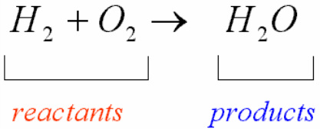

Slide 5
Start with this equation:
NaOH + H₂SO₄ → Na₂SO₄ + H₂O
Which are products?
Which are reactants?

Slide 6
There are 3 steps.
1. Make an element inventory.
Figure out how many atoms of each element in the reaction. Count them and make a list.
* Left = Reactants * Right = Products

Slide 7
An element inventory looks like this…
R P
Na 1 2
O 5 5
H 3 2
S 1 1
So it is clear, this reaction is NOT balanced. We do NOT have equal numbers of atoms on both sides.

Slide 8
2. Add coefficients in front of a compound
Must be whole number
Must be greater than 1
This is the ONLY thing you can do/add
What happens when we put a coefficient in front of a compound?
Every element in the compound is multiplied by that number.

Slide 9
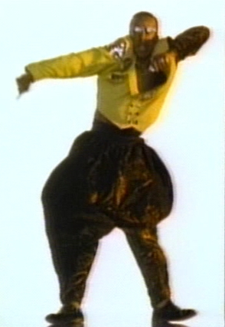
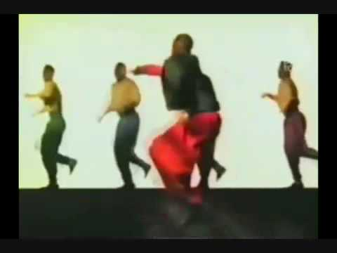
3. U can’t touch this…
You can never add, change or
remove SUBSCRIPTS.
Never.
Ever.
Ever.
Do not mess with them.
They are part of the formula!

Slide 10
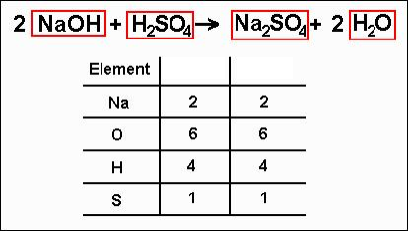
Reactants
Products
*The equation is now balanced!
**You update/adjust your element inventory as you go. I always cross out my #’s on my chart, do not erase them. IT is good to always SEE the original count, what you started with, bc sometimes your first attempt (the first coefficient you try) isn’t the right one. If you’re able to SEE your original count it makes it easier to try again. ☺
Notes:
10

Slide 11
Practice problems.
1. NaCl + BeF₂ --> NaF + BeCl₂
2. FeCl₃ + Be₃(PO₄)₂ --> BeCl₂ + FePO₄
3. AgNO₃ + LiOH --> AgOH + LiNO₃
4. Mg + Mn₂O₃ --> MgO + Mn
Notes:
11

Slide 12
Practice problems VIDEO
https://www.youtube.com/watch?v=eNsVaUCzvLA

Slide 13
Video
https://www.youtube.com/watch?v=yA3TZJ2em6g

